Slide 1
BHARATHIAR UNIVERSITY,COIMBATORE DEPARTMENT OF COMPUTER APPLICATIONS
VIRTUAL ATM SYSTEM
Under The Guidance Of PROJECT BY
Dr. T. AMUDHA, M.C.A., M.Phil., Ph.D., SUGESH K
Professor, MCA II
Department of Computer Applications 22CSEA70

Slide 2
INTRODUCTION
The Virtual ATM System is meticulously designed as a sophisticated tool tailored for backend developers to validate and ensure the seamless functionality of any updates or new features. Simultaneously, it serves as a user-friendly interface for customers, providing a simulated ATM experience.
On the user front, the Virtual ATM System mimics the functionality of a real ATM. Users can engage in activities such as balance inquiries, cash withdrawals, and deposits.
The system provides a secure and realistic environment for users to familiarize themselves with the interface before interacting with physical ATMs.
This dual-purpose functionality makes the Virtual ATM System a versatile solution that caters to the needs of both developers and end-users.

Slide 3
EXISTING SYSTEM
Banks may develop or adopt testing tools tailored to their specific systems, including virtualization features for ATM functionalities.
Independent software providers may offer testing tools and simulators for ATM systems, providing a generic environment for developers.
The primary aim is to provide a controlled environment for backend developers to test updates, new features, and overall functionality without impacting the live system.
It includes simulation of ATM transactions, error scenarios, and integration testing with backend systems.
This virtual environment allows developers to ensure that the software performs as expected before it is deployed to production ATMs.

Slide 4
PROPOSED SYSTEM
Designing a virtual ATM system for backend development and user testing involves creating a comprehensive environment that fulfills the needs of both developers and end-users.
A user-friendly web-based interface specifically designed for backend developers.
Allows developers to simulate ATM transactions, test new features, and validate updates in a controlled environment.
Frontend: JAVA for a responsive and interactive user interface.
Backend: MySQL for a storing the transactions details and efficient backend.

Slide 5
INPUT DESIGN
User Authentication(password, PIN)
Main Menu(Withdrawal, Deposit,BalanceInquiry, Loan)
Transaction Forms
Security Measures
Exit Option
Screen size
Visual Design

Slide 6
OUTPUT DESIGN
Transaction Confirmation
Receipt Options
Balance Information
Transaction History
Logout Confirmation
Responsive Design

Slide 7
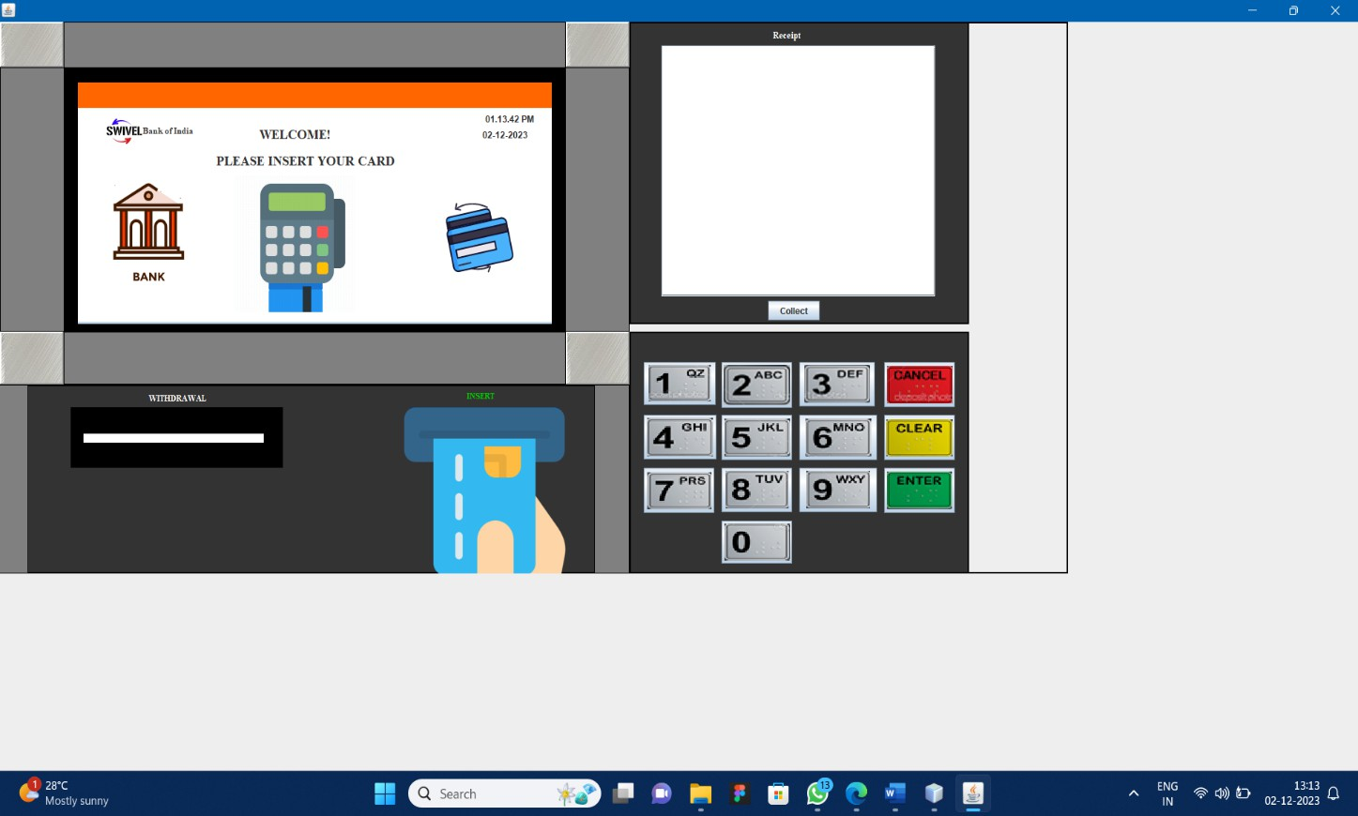
SCREENSHOTS
Main Page ATM simulator

Slide 8
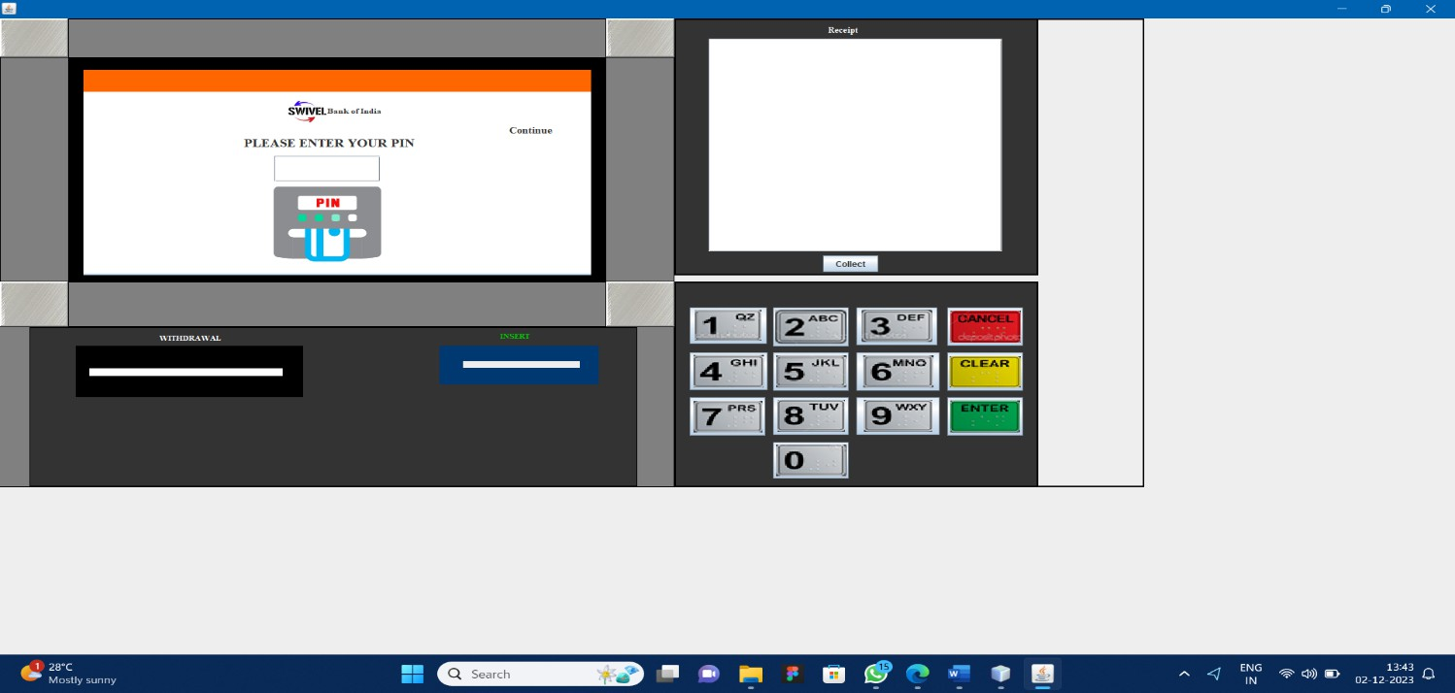
Pin Function For the ATM simulator

Slide 9
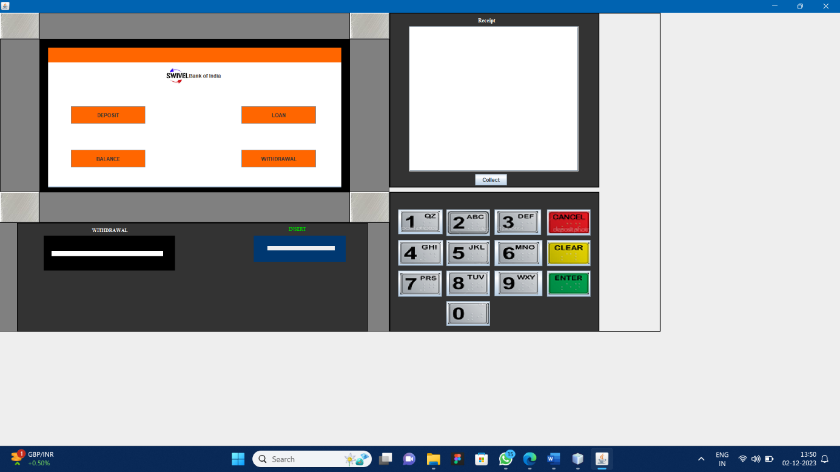
Module Page after successfully enter the correct pin

Slide 10
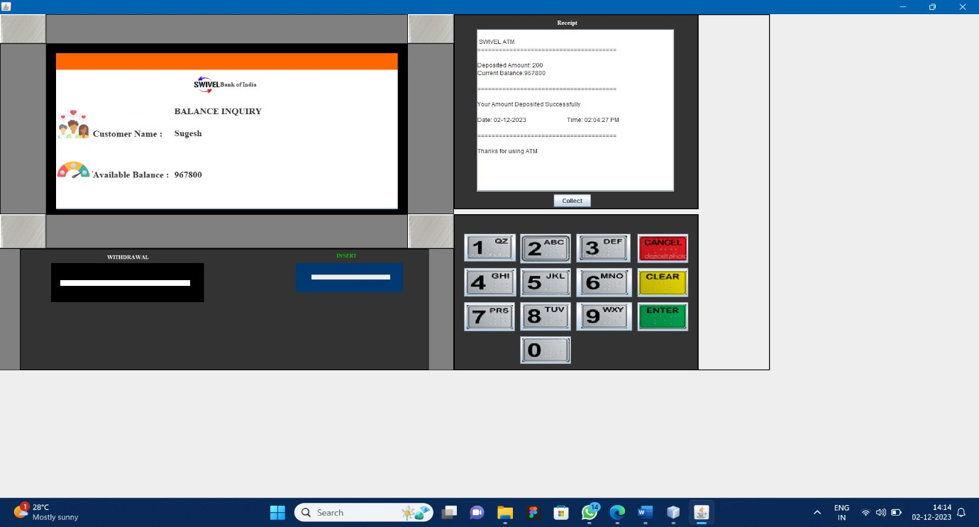
For example
if we want to check the balance enquiry then choose the BALANCE opotion in that page and it navigate into Balance details page that so the Current balance details in it

Slide 11
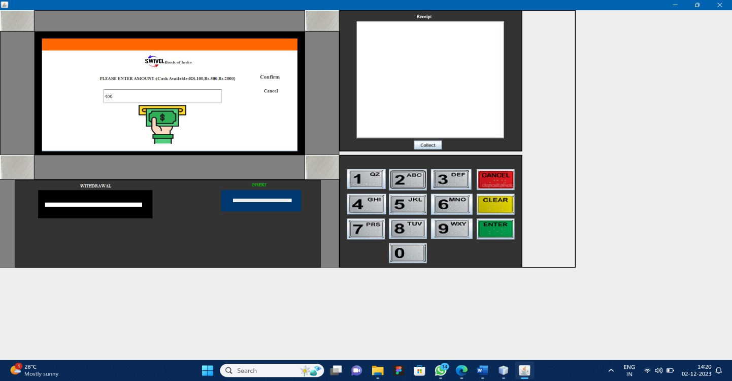
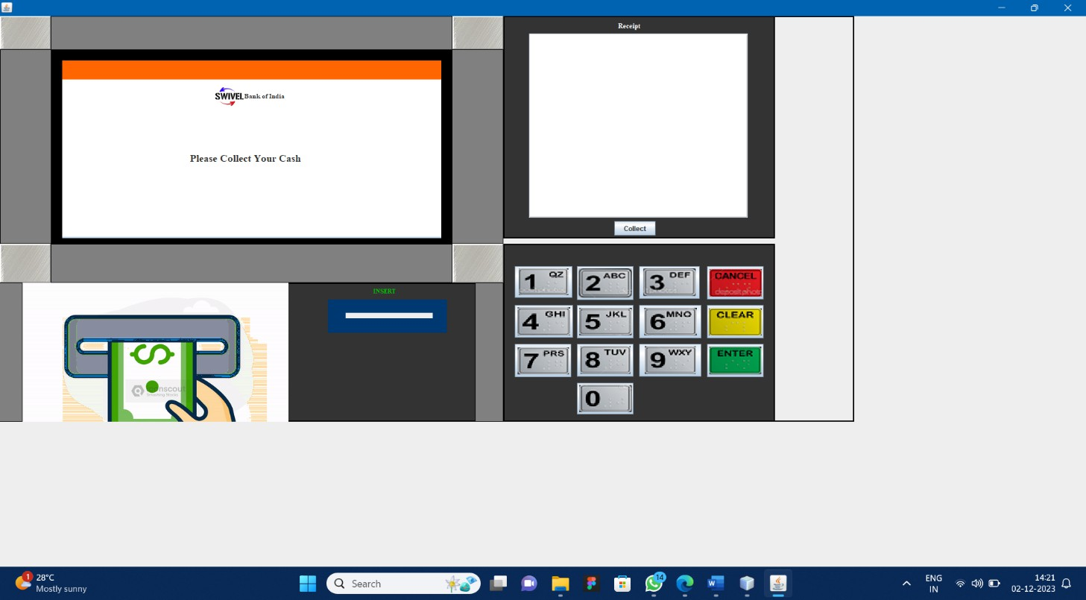
For Withdrawal Option there is an additional Functions is that collecting a Cash.

Slide 12
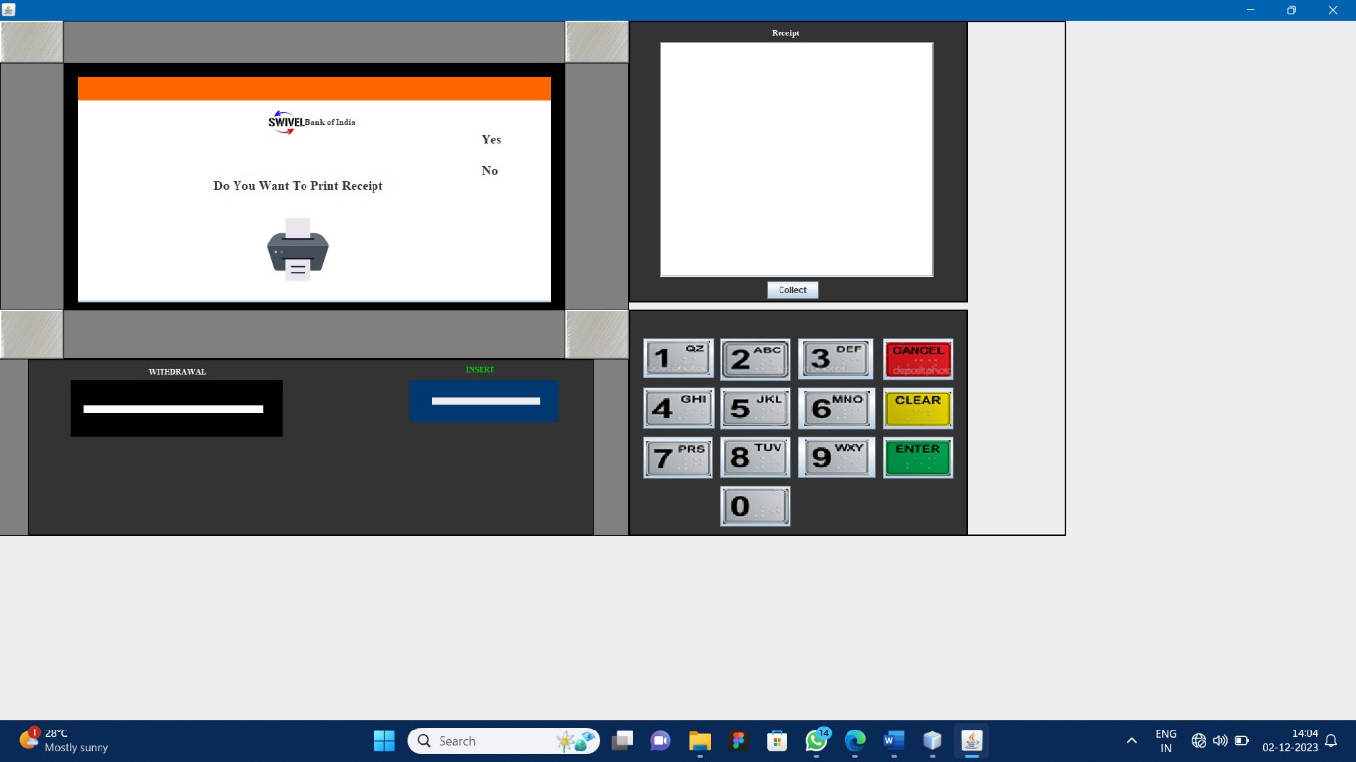
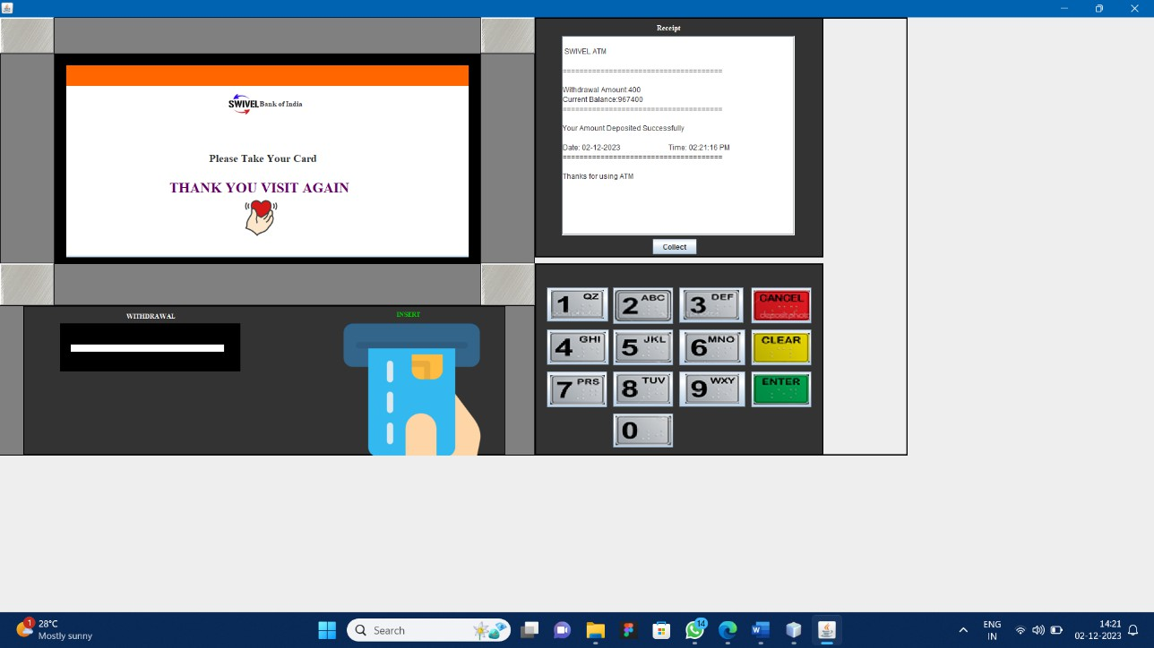
then generate Receipt functions and also the Transactions details on it.

Slide 13
CONCLUSION
Thus, ATM is one of the gifts from the inventor to humanity and it is the easiest way of depositing and withdrawing money. Transaction is possible at any time in ATMs, that is why in India some people called ATM as "all-time money". Hence it can be concluded that the project titled ATM Management is safe, fast, reliable, convenient and any time accessible money machine.
FUTURE ENHANCEMENTS:
OTP generation.
Email and mobile alerts.
Security upgrades like Visual Sensors with burglar alarms, Biometric Identification procedures etc.

Slide 14
THANK YOU

